Slide 1
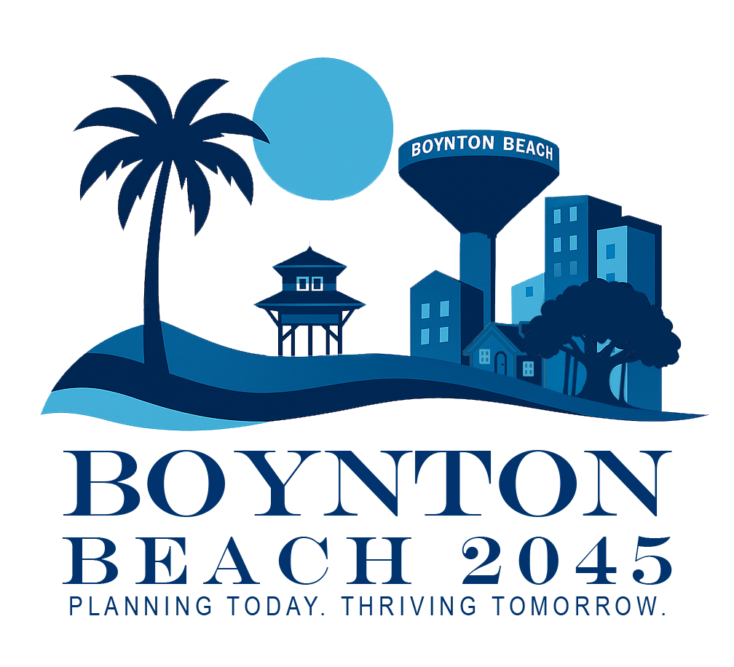

Comprehensive Plan Update Kick-off Presentation
JULY 15, 2025

Slide 2

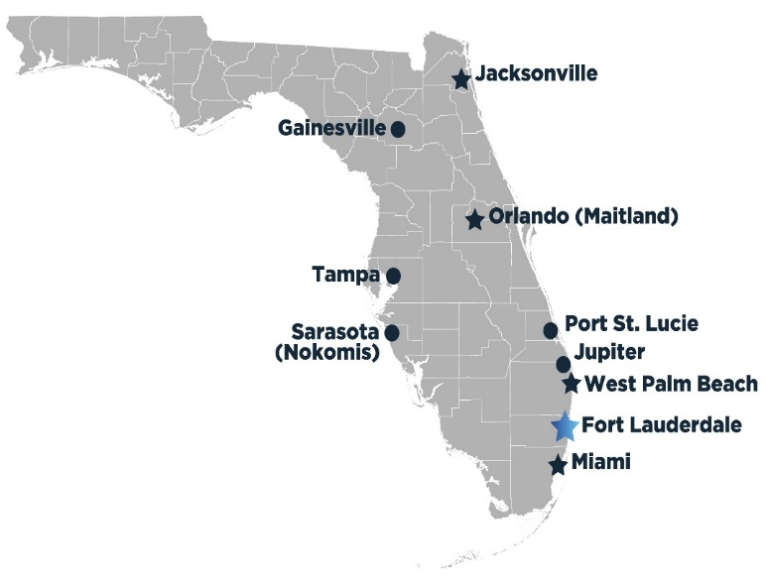
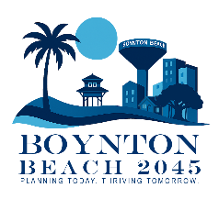
We believe in Teamwork and
close coordination with the City Staff
Founded in Florida in 1986
Multi-discipline full-service firm whose services include Planning, Civil Engineering, Utility Engineering, Water Resources, Transportation, Environmental Specialist, Landscape Architecture, Electrical Engineering & Construction Engineering Services - Over 150 full time employees
Established Reputation in Palm Beach County
WHO ARE WE?

Slide 3
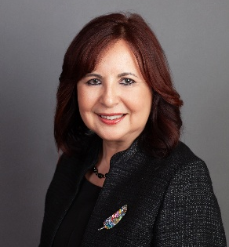
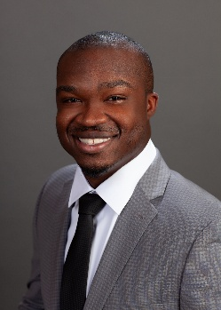
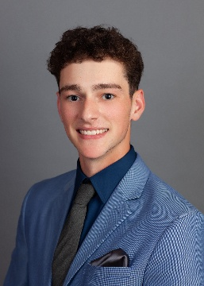
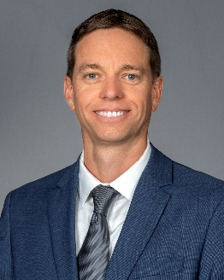
CMA PROJECT TEAM
Multidisciplinary, Experienced Team, Established Reputation in
Palm Beach County
Proven Track Record of Successful Comprehensive Plans in Compliance with Florida Statutes
Nilsa Zacarias, AICP
Director of Planning
CMA, Over 25 years
of Planning and
Comprehensive Plans and Public Engagement
Osniel Leon, AICP
Principal Planner, Proficient experience in Comprehensive Plan, Land Development, Urban Design, Site Planning and Aﬀordable Housing Studies and Public Engagement
Lance Lilly,
Senior Planner, experience
encompasses zoning codes, site plan reviews, and Comprehensive Plans and Public Engagement
Matthew Veneziano,
GIS Planner, Superior analytical skills ArcGIS Pro, AutoCAD, Public Participation. Boynton Beach resident
Suzanne Dombrowski, P.E., ENV SP,
Civil Engineer
Expertise in municipal utility, drainage, and roadway projects
Brent Whitefield, P.E., ENV SP, F.ASCE
Coastal Management and Resiliency Engineer as
varied as hydrologic and hydraulic modeling related to environmental and ﬂood protection
studies

Slide 4
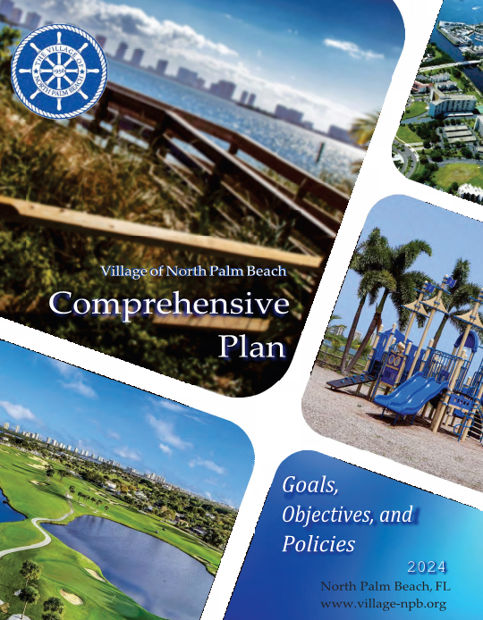
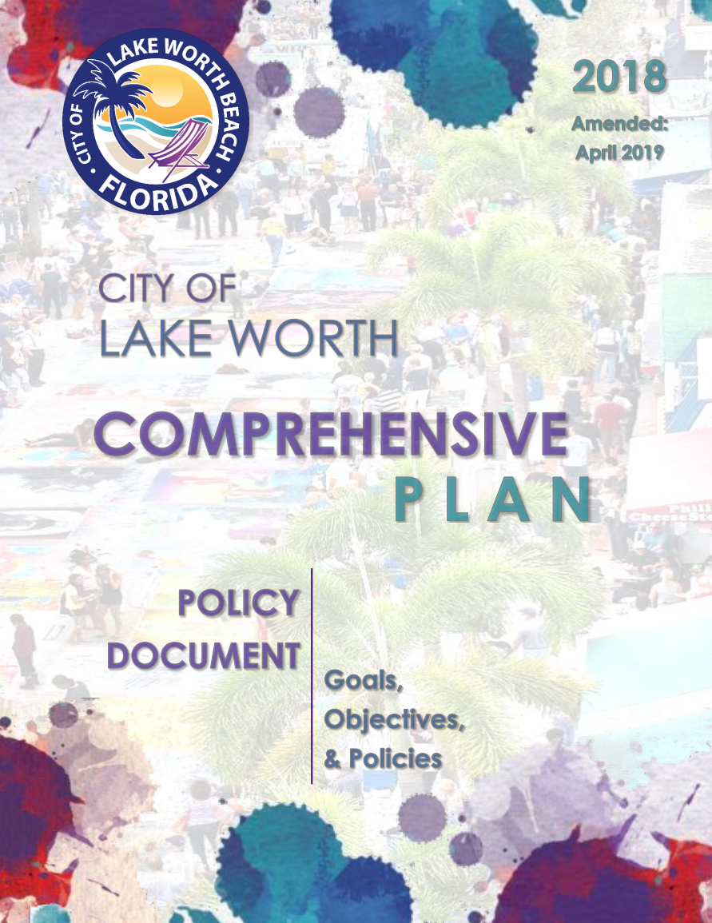
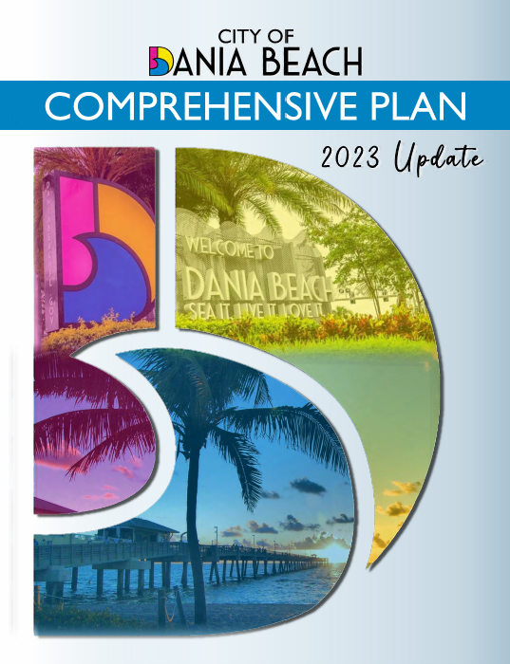
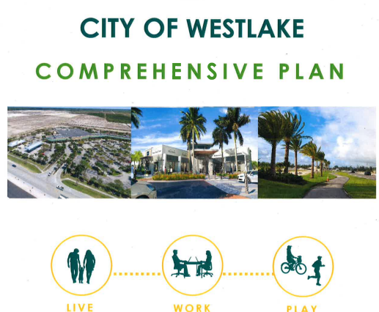
Extensive Experience in Preparation of Comprehensive Plans
City of Lake Worth Beach
City of Dania Beach
City of Delray Beach
City of Westlake
City of Delray Beach
Town of Manalapan
Town of Palm Beach
Town of Mangonia Park
Village of Tequesta
Village of North Palm Beach

Slide 5
WHAT IS THE COMPREHENSIVE PLAN AND WHY IS IT IMPORTANT?

Slide 6
FLORIDA STATUTES
Chapter 163
Florida Growth Management Act (Adopted 1985)
Counties and municipalities adopt Comprehensive Planning and Land Development Regulation Act

Slide 7

FLORIDA STATUTES
Chapter 163
Department of Commerce Florida's Land Planning Agency
Responsible for Guiding the State's Growth and Development

Slide 8
Boynton Beach
Operating Budget & CIP
Departmental Programs and Services
Strategic Plan
Comprehensive Plan
Vision and Values
Florida Statues
Notes:
This process does not include changes to the City’s land development regulations or site plan requirements.

Slide 9
SECTION 163.3191, F.S.
Every 7 years local government has the opportunity to assess
Comprehensive Plan
Revise and Update Plan: 10 and 20 Years Planning Horizon
Community Vision
Changes in State Legislation
Trends and Challenges Affecting the Community – Changing Conditions

Slide 10
Future Land Use
Transportation Utilities
Conservation
Housing
Recreation and Open Space
Coastal Management
Intergovernmental Coordination
Capital Improvements
Private Property Rights
Project Team
will Review and
Update each
Chapter or “Element”
Policy Document:
Goals, Objectives, Policies
Technical Document:
Data & Analysis and Map Series
Notes:
These are the existing Comprehensive Plan elements which the project team along with city staff will update and some element names might change for the final Comp Plan document.

Slide 11
WHAT ARE THE ATTRIBUTES OF A SUSTAINABLE COMMUNITY?
Plans strategically and responsibly to balance growth with long-term livability, environmental health, and economic stability.
Encourages compact, mixed-use development that reduces sprawl and preserves open land.
Supports all residents with access to services, housing, and transportation, regardless of income or background.
Minimizes waste and energy use, and invests in renewable or low-impact infrastructure.
“A sustainable community uses its resources to meet current needs while supporting that adequate resources are available for future generations”
Notes:
This means that plans strategically and responsibly balance growth with long-term livability, environmental health, and economic stability. Encourages compact, mixed-use development that reduces sprawl and preserves open land. Supports long-term job growth and diversified economic opportunities. Ensures all residents have access to services, housing, and transportation, regardless of income or background. Minimizes waste and energy use, and invests in renewable or low-impact infrastructure.

Slide 12

Protect
Protect city’s identity and character
Embrace
Embrace resiliency and sustainability
Preserve
Preserve city’s values
Adopt
Adopt long term strategies
Provide
Provide quality of life
Promote
Promote community partners
Encourage
Encourage sustainable development
Notes:
Protect Quality of life of residents and support business community
Embrace Community Participation and Dialogue
Preserve Historic Character & community Identity
Protect its Natural and Built Environment, encourage Urban forestry
Adopt sea level rise policies and regulations
Provide Walkable, Mixed-Use Developments and Support Multi-Modal Transportation Network
Promote Sustainable Practices (drainage, green buildings and site plans, etc.)
Encourage interconnected public open spaces and civic gathering places

Slide 13

PUBLIC OUTREACH GOALS & OBJECTIVES
Inclusivity
Transparency
Quality Input
Continuous Engagement
Notes:
Inclusivity: reach residents, businesses, commuters, visitors and underrepresented groups
Transparency: Clearly explain process, timelines, and decision-making.
Quality Input: Obtain actionable feedback on land use, transportation, housing, resilience, growth affordability, and civic amenities.
Continuous Engagement: Maintain outreach throughout the process, not just at milestones.

Slide 14
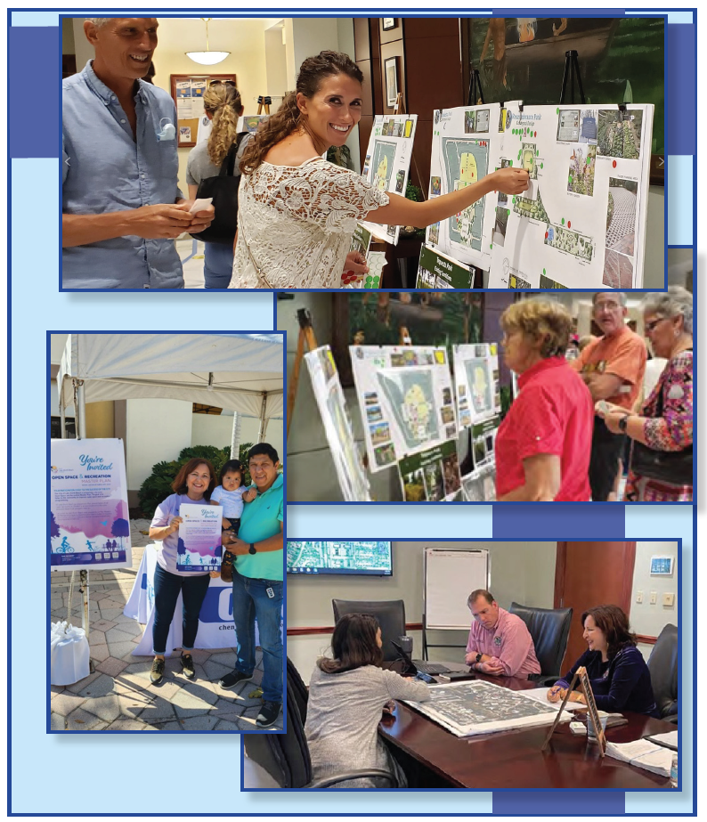
Community Input is the Cornerstone of the Comprehensive Plan
In- Person Public Meeting
Kick-off Workshop
Themed Workshops (2-3 Sessions)
City Halls (Two)
Pop-up Outreach (Kiosk at City events)
Virtual Public Meeting
Webinars (Kickoff, Themed Workshops, City Halls)
Virtual Open-House
Digital Engagement
Survey with QR code
Online Mapping Tool
Social Media Outreach
Email Newsletters
Localized Media
OUTREACH CATEGORIES & METHODS?
Notes:
IN PERSON MEETINGS
Kick‑off Workshop
Venue: City Hall Annex or Community Center
Features: Presentation on scope, open house/discussion stations
Timing: Evening (Tuesday or Thursday) to accommodate work schedules
Themed Workshops (2–3 sessions):
Themes: Environment & Resilience; Transportation & Mobility; Housing & Neighborhoods
Includes stakeholder panels, interactive exercises (e.g., mapping of desired changes), facilitated discussions
City Halls (two):
Mid‑process: present draft goals/options for feedback
Final plan review: gather endorsements or refinements
Pop‑Up Outreach
Host at public gathering spaces (e.g., library, park, shopping centers) to engage walk‑ins
VIRTUAL PUBLIC MEETING
Webinars (Kickoff, Themed Workshops, City Halls)
Held via Zoom or Webex, livestreaming on YouTube and Facebook
Include interactive polls and Q&A; record and archive for on‑demand viewing
Virtual Open‑House Platform
Interactive website with preliminary plan materials, maps, comment cards, survey links
DIGITAL ENGAGEMENT
Interactive Survey
Topics: priorities, satisfaction indicators, order‑of‑preference exercises
Mobile‑friendly; available in English, Spanish, Haitian‑Creole
Online Mapping Tool
Map‑based activity: “Pin” areas needing change or preservation; record public comments
Social Media Outreach
Pages: dedicate Facebook, Instagram stories, polls
Boosted posts to reach underrepresented zip codes
Email Newsletters
Monthly updates via city newsletter; separate digest for tipping points/opportunities
Localized Media
Press releases to media outlets serving local, Spanish‑language, and Haitian‑Creole audiences

Slide 15
STEPS IN THE PROCESS
City Commission: Informational Presentation
JULY 15,
2025
Public Outreach & Participation
Date Day,
2025
7 to 8 weeks
Review & Update Plan Elements and Map Series
6 to 8 weeks
Final Draft Workshop with City Commission
Date Day,
2025
7 to 8 weeks
Public Hearing (Transmittal First Reading / State and 8 agencies)
6 to 8 weeks
Date Day,
2025
Public Hearing (Adoption)
7 to 8 weeks
After transmittal, the State will review and issue a report; then, Project Team will update document. City Commission Adoption (Second Reading).
Total: 33 to 40 weeks

Slide 16
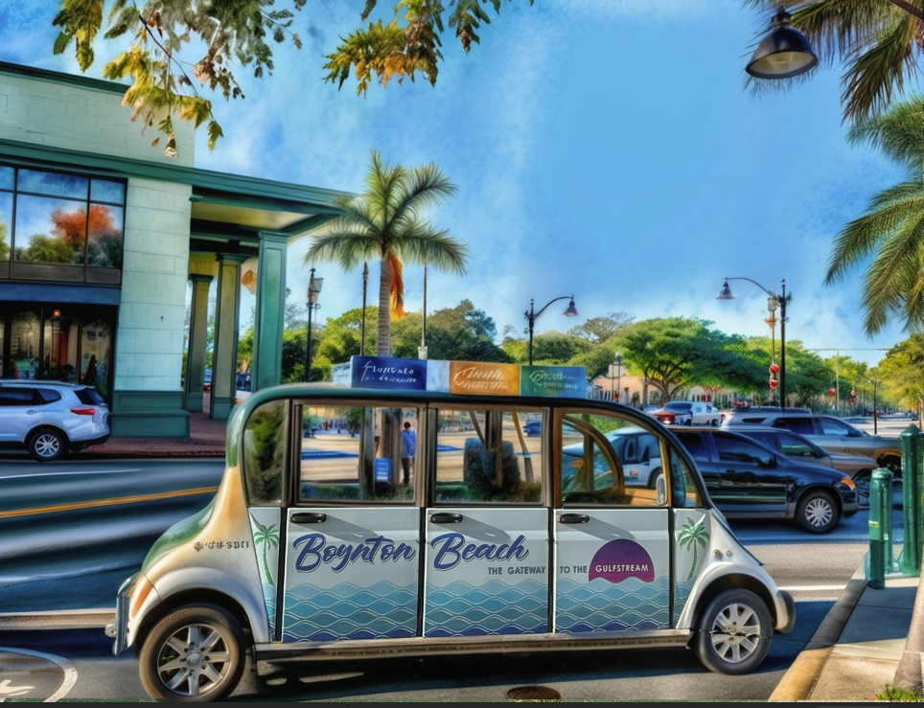

Thank you!
Questions?

