Slide 1
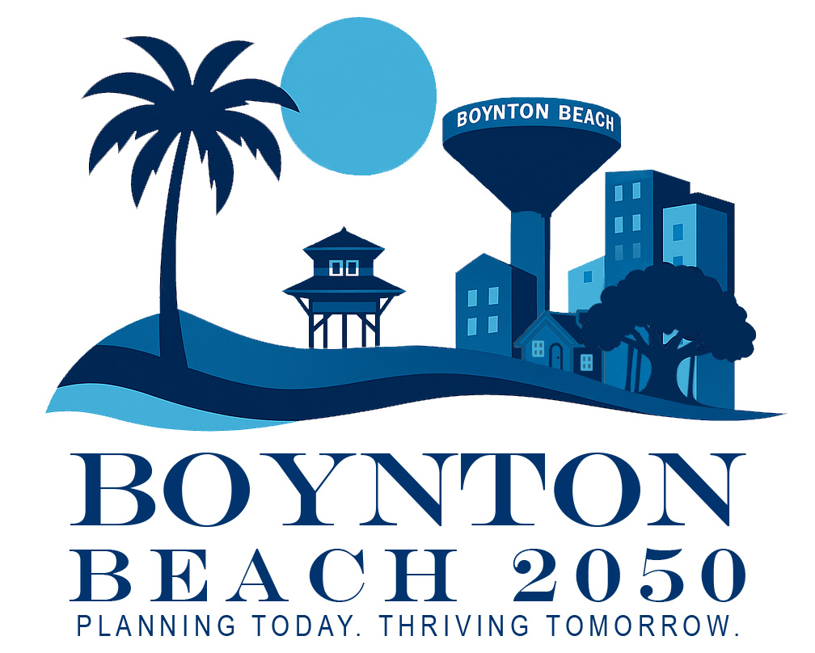

City Commission Workshop
City of Boynton Beach Comprehensive Plan Update
March 26, 2026

Slide 2

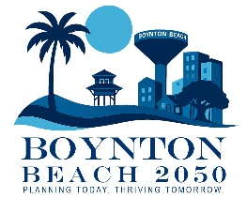

Overview of the Comprehensive Plan
Goals of this Workshop
Elements: Introduction, Future Land Use, Transportation and Mobility, Housing, Conservation, Coastal Management, Recreation and Open Space, Intergovernmental Coordination, Capital Improvement, Economic Development, Utilities, Private Property Rights
Framing Existing Goals
Next Steps
Workshop Agenda

Slide 3
What We Need From You?
Confirmation of planning priorities
Feedback on new goals/objectives/policies
Direction on trade-offs (growth vs. preservation, mobility vs. parking, etc.)

Slide 4
WHAT IS THE COMPREHENSIVE PLAN?

Slide 5

What is the Comprehensive Plan?
Required by Florida Statutes
Includes multiple Elements (chapters): Future Land Use, Housing, Infrastructure, etc.
A long-range blueprint for community growth and change
Guides development, housing, infrastructure, conservation

Slide 6
Boynton Beach
Operating Budget & CIP
Departmental Programs and Services
Strategic Plan
Comprehensive Plan
Vision and Values
Florida Statues
Notes:
This process does not include changes to the City’s land development regulations or site plan requirements.

Slide 7
Comprehensive Plan (Comp Plan) VS. Land Development Regulations (LDRs)
A comprehensive plan sets the long-term vision and goals for how a community should grow and develop
LDRs provide the specific rules and standards that control how that vision is implemented on individual properties
The comprehensive plan looks at broad issues like land use, transportation, and infrastructure, whereas LDRs focus on detailed requirements like zoning, setbacks, and design standards

Slide 8
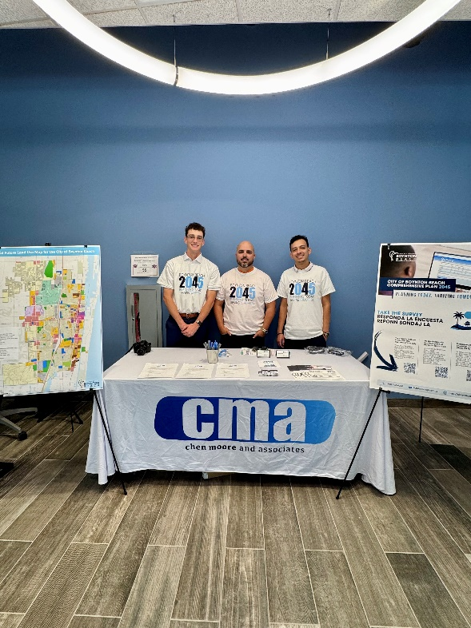
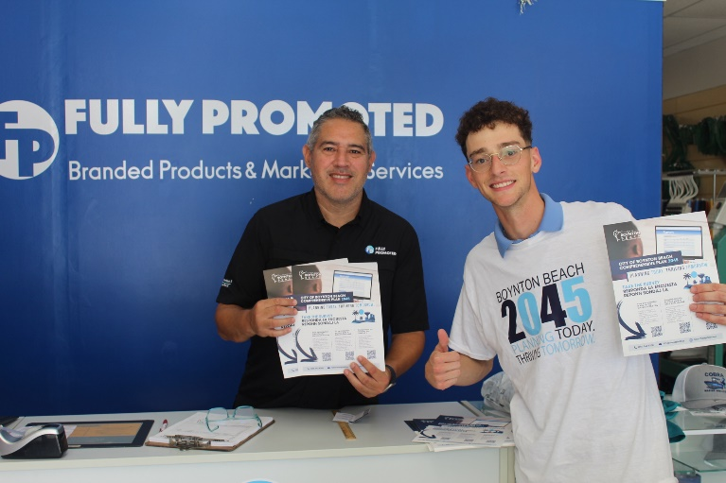
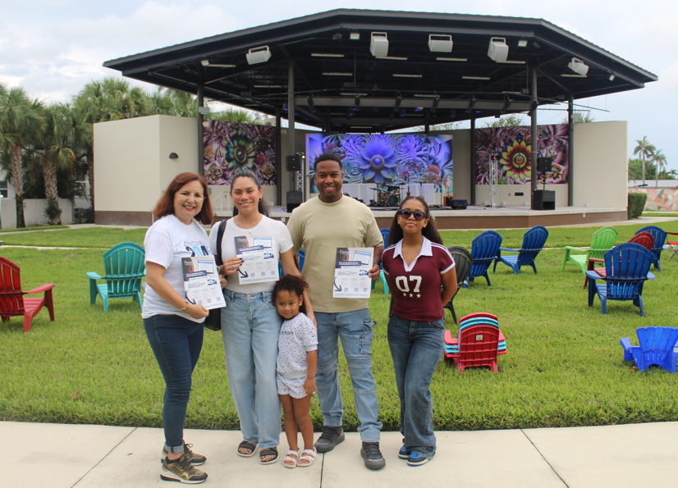
Community Input is the Cornerstone of the Comprehensive Plan
In- Person Public Meetings
  Kick-off Workshop
  Themed Workshops (2 Sessions)
  Pop-up Outreach (Kiosk at City events)
Digital Engagement
  Survey with QR code
  Online Mapping Tool
  Social Media Outreach
  Email Newsletters
  Localized Media
OUTREACH CATEGORIES & METHODS
Notes:
IN PERSON MEETINGS
Kick‑off Workshop
Venue: City Hall Annex or Community Center
Features: Presentation on scope, open house/discussion stations
Timing: Evening (Tuesday or Thursday) to accommodate work schedules
Themed Workshops (2–3 sessions):
Themes: Environment & Resilience; Transportation & Mobility; Housing & Neighborhoods
Includes stakeholder panels, interactive exercises (e.g., mapping of desired changes), facilitated discussions
City Halls (two):
Mid‑process: present draft goals/options for feedback
Final plan review: gather endorsements or refinements
Pop‑Up Outreach
Host at public gathering spaces (e.g., library, park, shopping centers) to engage walk‑ins
VIRTUAL PUBLIC MEETING
Webinars (Kickoff, Themed Workshops, City Halls)
Held via Zoom or Webex, livestreaming on YouTube and Facebook
Include interactive polls and Q&A; record and archive for on‑demand viewing
Virtual Open‑House Platform
Interactive website with preliminary plan materials, maps, comment cards, survey links
DIGITAL ENGAGEMENT
Interactive Survey
Topics: priorities, satisfaction indicators, order‑of‑preference exercises
Mobile‑friendly; available in English, Spanish, Haitian‑Creole
Online Mapping Tool
Map‑based activity: “Pin” areas needing change or preservation; record public comments
Social Media Outreach
Pages: dedicate Facebook, Instagram stories, polls
Boosted posts to reach underrepresented zip codes
Email Newsletters
Monthly updates via city newsletter; separate digest for tipping points/opportunities
Localized Media
Press releases to media outlets serving local, Spanish‑language, and Haitian‑Creole audiences

Slide 9
Highlighted Community Survey Results
Total Responses: 240

Slide 10
COMMUNITY SURVEY RESULTS – QUESTION 8
Top 3 Responses:
Lack of Retail Options/Stores
School System
Public Transportation Options

Slide 11
COMMUNITY SURVEY RESULTS – QUESTION 9
Top 3 Responses:
Increased Safety
Beautification of the City
Land Conservation/Environmental Stewardship

Slide 12
COMMUNITY SURVEY RESULTS – QUESTION 10
Top 3 Responses:
Police/Crime Prevention
Traffic Management
Environment Protection/Preservation

Slide 13
COMMUNITY SURVEY RESULTS – QUESTION 11
Top 3 Responses:
Focus on Design Features for Site Plan and Building
Regulate Type/Variety of Businesses (locally owned, national chains)
Encourage Mixed-Use Development Patterns

Slide 14
COMMUNITY SURVEY RESULTS – QUESTION 12
Top 3 Responses:
Protect neighborhoods from degradation caused by aging, vacant or abandoned properties
Promote housing for young families and entry-level professionals
Preserve community character in new developments

Slide 15
COMMUNITY SURVEY RESULTS – QUESTION 13
Top 3 Responses:
Landscaping and Trees (encourage additional plantings)
Water (quantity and quality)
Land Management (mixed use developments, purchase land for open space, outdoor recreation, tree canopy protection)

Slide 16
COMMUNITY SURVEY RESULTS – QUESTION 14
Top 3 Responses:
Access to Open Space (neighborhood park, tot lot, walking trail)
Additional Trees
Sidewalks

Slide 17
Policy Document:
Goals, Objectives, Policies
Technical Document:
Data & Analysis and Map Series
  Introduction
  Future Land Use
  Transportation and Mobility Utilities
  Conservation
  Housing and Neighborhood
  Recreation and Open Space
  Coastal Management
  Intergovernmental Coordination
  Economic Development (NEW)
  Capital Improvements
  Private Property Rights
GOALS OF THIS WORKSHOP
Discuss and Review Policy and Technical Document Updates for all Chapters or “Elements”

Slide 18
INTRODUCTION ELEMENT

Slide 19
INTRODUCTION ELEMENT
City Background, Location, History, etc.
Public Engagement Process
Population and Socio-Economic Analysis
Characteristics of the Population: Households, Age, Race, Origin, Education, Employment, Occupation, Income, Poverty Level, Population Projections

Slide 20
INTRODUCTION ELEMENT
Population Projections Permanent and Seasonal
Projected Total Population City of Boynton Beach 2010-2050
Year | 2010 | 2020 | 2025 | 2030 | 2035 | 2040 | 2045 | 2050
Total: | 68,217 | 80,380 | 84,391 | 89,158 | 92,687 | 95,468 | 97,691 | 99,613
Year | 2010 | 2020 | 2030 | 2040 | 2045 | 2050
Permanent Population | 68,217 | 80,380 | 89,158 | 95,468 | 97,691 | 99,613
Seasonal | 7,504 | 8,640 | 9,491 | 10,118 | 10,348 | 10,548
Total | 75,721 | 89,020 | 98,649 | 105,586 | 108,039 | 110,161

Slide 21
FUTURE LAND USE ELEMENT

Slide 22
FUTURE LAND USE ELEMENT
Defines how land is used: Residential, Commercial, Mixed-use, etc.
Influences Zoning, Development, and Infrastructure Investment
Focus on Infill, Redevelopment, and Walkable Urbanism
Includes Future Land Use Map (FLUM) and Community Redevelopment Area Map (CRAM)
Notes:
(Emphasize how the Comp Plan is a higher level document and not an LDR with the very specific development regulations)

Slide 23
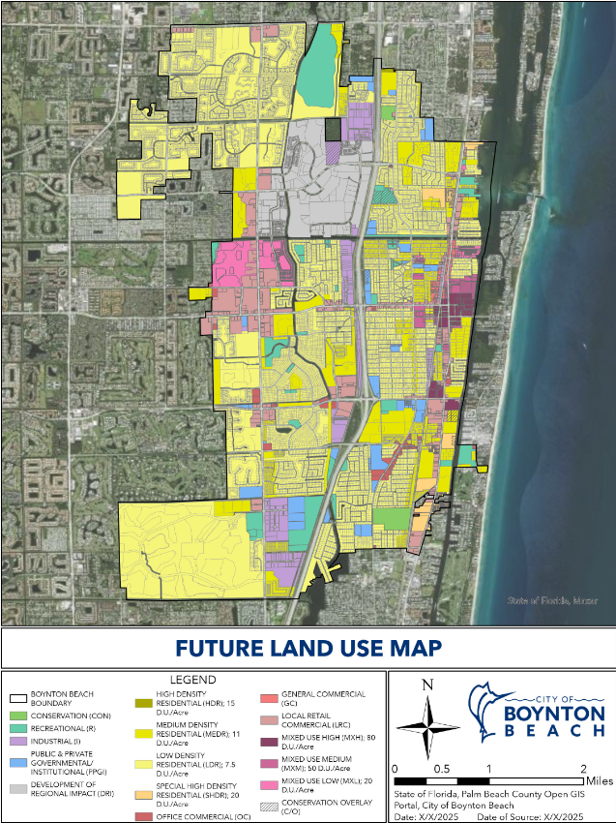
FUTURE LAND USE ELEMENT
Future Land Use Map (here)

Slide 24
FUTURE LAND USE ELEMENT
FUTURE LAND USE DESIGNATION | TOTAL NUMBER OF ACRES | PERCENT OF TOTAL
Residential | 6,359.64 | 74.4%
Commercial | 613.98 | 7.2%
Mixed-Use | 370.96 | 4.3%
Conservation | 151.3 | 1.8%
Public & Private Gov’t / Institutional (PPGI) | 244.43 | 2.9%
Recreation (R) | 462.58 | 5.4%
Industrial (I) | 349.82 | 4.1%
TOTAL ACREAGE | 8,552.71 | 100%

Slide 25
FUTURE LAND USE ELEMENT

Slide 26
FUTURE LAND USE ELEMENT
Added Objectives:
Objective 1.22 – Climate Resilience & Sustainability
Strengthen citywide climate resilience strategies
Improve energy efficiency and reduce emissions
Protect infrastructure and natural systems from climate impacts
Address sea level rise and extreme weather risks
Enhance public safety and long-term environmental sustainability
Objective 1.23 – Urban Tree Canopy & Partnerships
Expand and enhance the City’s tree canopy
Increase coordination with key agencies and districts
Support climate resilience through urban forestry
Improve air and water quality
Enhance neighborhood aesthetics and coastal character
Notes:
Objective 1.22: The City shall continue to support a sustainable and climate-resilient Boynton Beach by adopting and implementing strategies that improve energy efficiency, reduce greenhouse gas emissions, and protect public infrastructure, natural systems, coastal resources, and human life from the impacts of climate change, sea level rise, and extreme weather events.
Objective 1.23: The City shall continue to Coordinate with the City’s Sustainability & Resilience Division (SRD), the Community Redevelopment Agency (CRA), and relevant landscape districts to protect, expand, and enhance Boynton Beach’s tree canopy in order to maintain the City’s lush, coastal character, support climate resilience, improve air and water quality, and enhance the visual character of streets, neighborhoods, and redevelopment areas.

Slide 27
FUTURE LAND USE ELEMENT
Added Policies:
Prioritize reinvestment in existing parks over new land acquisition
Focus on park upgrades and improved greenway connections
Promote CRA redevelopment aligned with Complete Streets and urban design standards
Ensure land use changes are consistent with CRA planning framework
Maintain community character through area-specific design guidelines
Support quality of life and business stability
Continue coordination with School District on growth, capacity, and school siting
Maintain interlocal agreement for school planning
Support modernization of industrial areas
Ensure compatibility with surrounding neighborhoods
Notes:
Policy 1.3.3 Given the City’s built-out condition, prioritize enhancement and reinvestment in existing parks (facilities upgrades, greenway connections) over new land acquisition.
Policy 1.7.5 Within the CRA, prioritize redevelopment that implements the CRA Plan’s Complete Streets, activity nodes, and urban design guidelines; FLUM amendments in the CRA shall demonstrate consistency with these frameworks.
Policy 1.9.6 The City shall continue to protect the character of the City, the quality of life of residents, and support the business community for consistency and predictability by implementing design guidelines suitable for specific areas.
Policy 1.16.9 The City shall maintain and implement the Interlocal Agreement for Public School Facility Planning required by 163.31777, F.S., and use it to coordinate population projections, school siting, capacity, and concurrency with the School District.
Policy 1.17.10 The City shall support industrial modernization while maintaining compatible boundaries with nearby neighborhoods.

Slide 28
HOUSING ELEMENT

Slide 29
HOUSING ELEMENT
Highlights Housing Issues, Challenges and Recommendations
Addresses Housing Supply, Affordability, and Conditions
Supports Diverse Housing Types and Price Points
Ties into Redevelopment and Equitable Growth Strategies

Slide 30
HOUSING ELEMENT
What This Does NOT Do
Does not rezone neighborhoods
Does not approve projects
Only sets policy guardrails

Slide 31
HOUSING ELEMENT
Housing Occupancy | City of Boynton Beach
 | 2013 |  | 2023
 | Estimate | Percent | Estimate | Percent
Total housing units | 36,993 | 100.0% | 40,964 | 100.0%
Occupied housing units | 28,846 | 78.0% | 33,297 | 81.8%
Vacant housing units | 8,147 | 22.0% | 3,060 | 18.2%
Homeowner Vacancy Rate | 1.4 | (x) | 1.6 | (x)
Rental Vacancy Rate | 6.2 | (x) | 9.6 | (x)

Slide 32
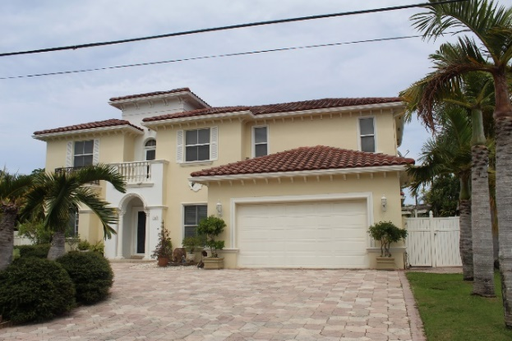
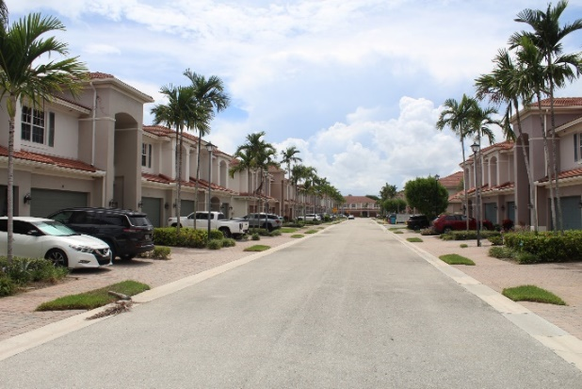
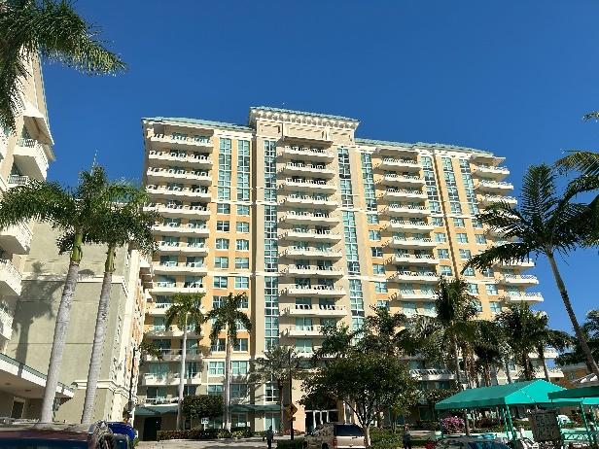
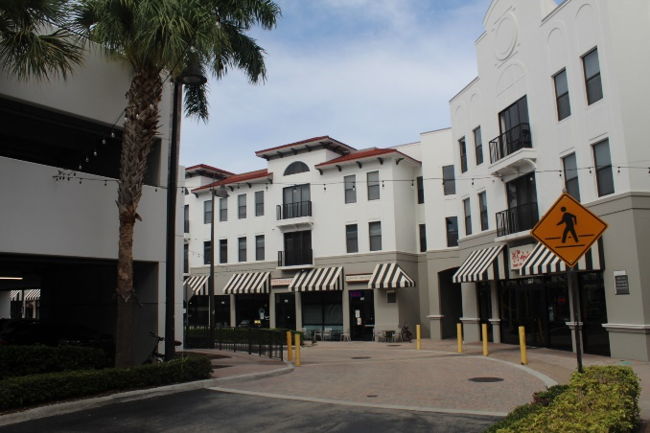
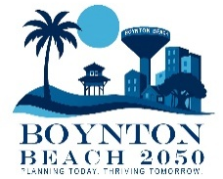
HOUSING ELEMENT
TYPES OF HOUSING

Slide 33
HOUSING ELEMENT
Added/Updated Goals:
Goal 6.1 – Housing
Expand diverse housing options for current and future residents
Support both homeowners and renters
Align housing with neighborhood character
Plan for long-term housing needs through 2050
Goal 6.2 – Neighborhoods
Promote stable, resilient, and well-planned neighborhoods
Encourage reinvestment and revitalization
Support inclusive community engagement
Enhance livability, safety, and affordability for all residents
Notes:
Goal 6.1: To provide decent, safe, and sanitary housing in suitable neighborhood environments at a range of costs and variety of types necessary to meet the needs of present and future residents of the City. To achieve a diverse and sustainable supply of housing stock for homeowners and renters residents all current and future, in neighborhoods consistent with the character of the City for next 10 (2035) and 20 (2045) year planning period.
Goal 6.2: To create, preserve, and enhance stable, resilient, and well-structured neighborhoods within Boynton Beach by promoting neighborhood planning, reinvestment, revitalization, and inclusive community participation. Neighborhoods should offer complete, sustainable, and high-quality living environments that support a strong sense of identity, safety, affordability, and long-term livability for residents of all ages and income levels.

Slide 34
HOUSING ELEMENT
Added Objectives:
Objective 6.2.1 – Neighborhood Planning Program
Establish a citywide Neighborhood Planning Program by 2030
Focus on preservation, stabilization, and revitalization
Support reinvestment and compatible infill development
Address unique neighborhood needs
Reinforce “City of Neighborhoods” identity
Objective 6.2.2 – Neighborhood Improvements
Utilize neighborhood plans and targeted strategies
Strengthen code enforcement and reinvestment programs
Provide incentives for neighborhood improvements
Enhance quality, safety, and sustainability
Notes:
Objective 6.2.1: By 2030, the City shall establish and maintain a Neighborhood Planning Program that guides preservation, stabilization, and revitalization of existing neighborhoods; supports reinvestment and infill development; and addresses unique community needs identified in the Housing Element’s Data & Analysis. The program shall strengthen Boynton Beach’s character as a “City of Neighborhoods” and support implementation of housing strategies citywide.
Objective 6.2.2: The City shall use Neighborhood Plans, code enforcement strategies, reinvestment programs, and incentives to maintain and improve the quality, safety, and sustainability of Boynton Beach neighborhoods.

Slide 35
HOUSING ELEMENT
Added Policies:
Ensure compatibility between residential and nonresidential uses
Promote smooth transitions between neighborhoods
Require new development to respect existing neighborhood character
Encourage improvements to existing homes and properties
Support diverse housing options for all household types
Establish clear guidelines and process for Neighborhood Plans
Prioritize areas with disinvestment and infrastructure needs
Ensure strong community involvement in planning
Implement neighborhood-level improvements (lighting, walkability, traffic calming)
Support neighborhood and civic organizations
Continue targeted code enforcement and anti-blight efforts
Notes:
Policy 6.2.5: Residential areas shall be adequately buffered from incompatible nonresidential uses and provide sensitive transitions between neighborhoods to eliminate any adverse effects to residents.
Policy 6.8.6: Require new development, both private and public, to respect and respond to existing physical characteristics — buildings, streetscapes, open spaces, etc. — that contribute to the overall character and livability of the neighborhood.
Policy 6.8.7: The City to encourages the structural and aesthetic improvement of existing homes in need of enhancements.
Policy 6.9.8: Support a variety of housing to reflect the needs of all households, including both rental and ownership opportunities for single people, couples, families, seniors, persons with disabilities and multi-generational families.
Policy 6.2.1.1: The City shall prepare written guidelines and rules for the creation and adoption of Neighborhood Plans, ensuring consistency with the Comprehensive Plan and Housing Element. Guidelines shall include:
Preparation of neighborhood plans jointly by City staff (Neighborhood Services, Planning & Zoning, and Housing programs) and neighborhood residents.
Prioritization of neighborhoods experiencing disinvestment, aging housing stock, infrastructure deficiencies, or incompatibility pressures, consistent with the Housing Element’s identification of at-risk areas.
Verification of community support to ensure that plans reflect the desires of a sufficient and diverse representation of neighborhood residents.
Designation of neighborhood contacts or planning groups through an inclusive, publicly advertised selection process.
Consistent review of neighborhood plans with all relevant Goals, Objectives, and Policies, followed by presentation and adoption by City Commission.
Policy 6.2.2.1: The City shall implement neighborhood-level strategies such as lighting upgrades, walkability improvements, landscaping, signage, and traffic calming, as identified in the Housing Element, to enhance neighborhood character and safety.
Policy 6.2.2.2: The City shall encourage the formation of neighborhood, civic, or business organizations to assist in identifying issues, promoting community pride, and coordinating with City staff.
Policy 6.2.2.3 The City shall continue targeted code enforcement, rehabilitation support, and blight-removal strategies in Neighborhood Target Areas, as identified in the Housing Element.

Slide 36
Transportation and Mobility Element

Slide 37
TRANSPORTATION AND MOBILITY ELEMENT
Address Existing Transportation Conditions
Guide Improvements and Funding to Identify Road, Transit, and Trail Projects, sets Level-of-Service Standards
Coordinate Land Use and Mobility to ensure Growth Patterns, Support Efficient Travel, and Promote Multimodal Options

Slide 38
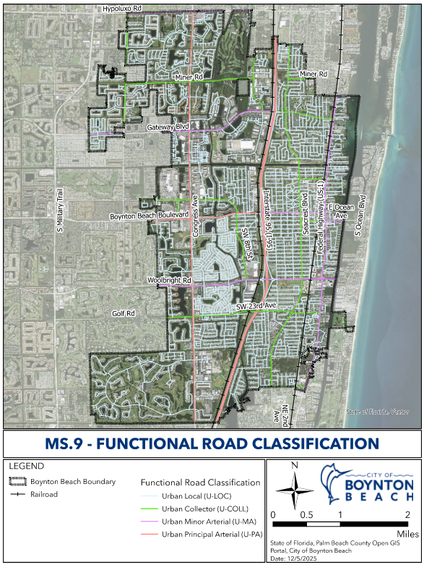
TRANSPORTATION AND MOBILITY ELEMENT

Slide 39
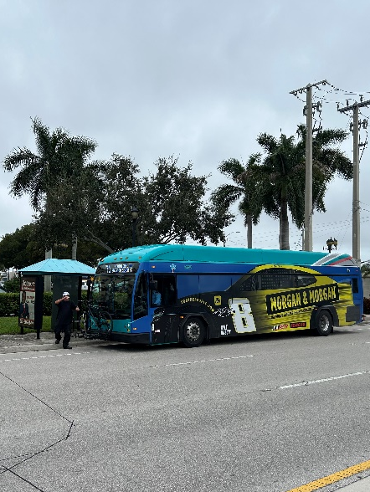
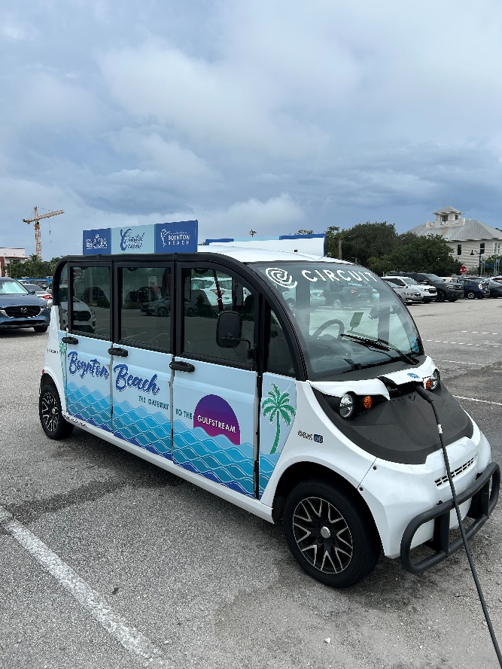
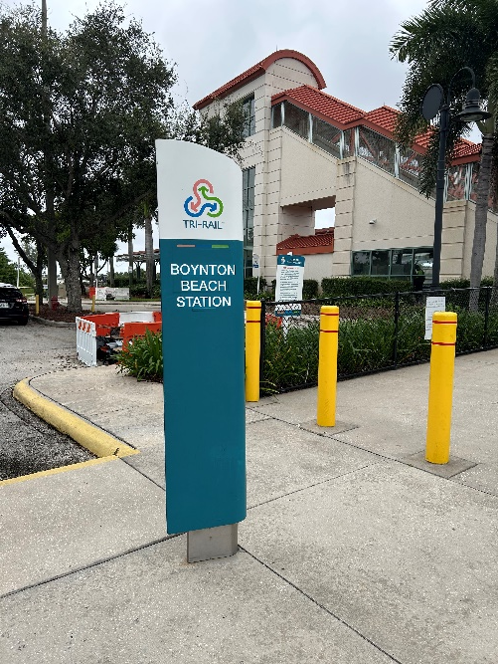
TRANSPORTATION AND MOBILITY ELEMENT
PUBLIC TRANSIT NETWORKS
PALM TRAN
COASTAL CRUISER
TRI-RAIL

Slide 40
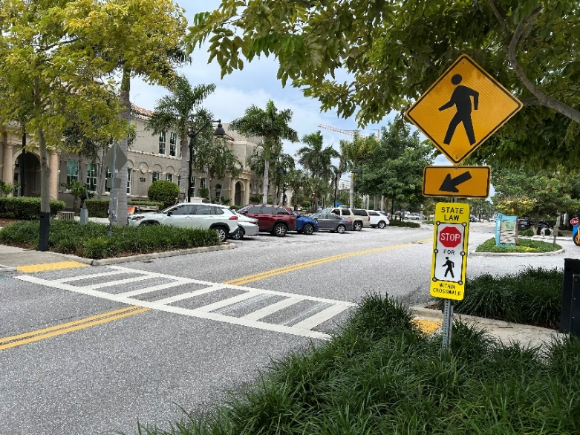
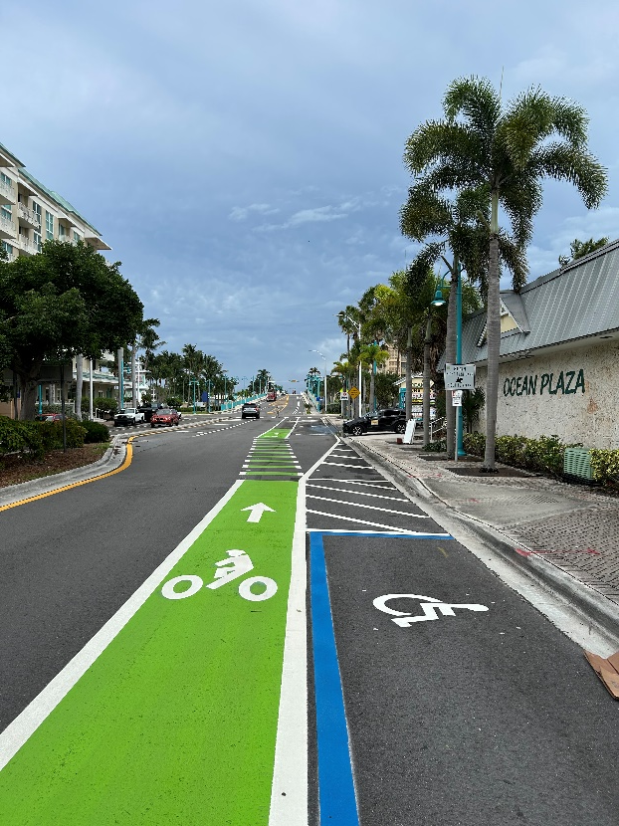
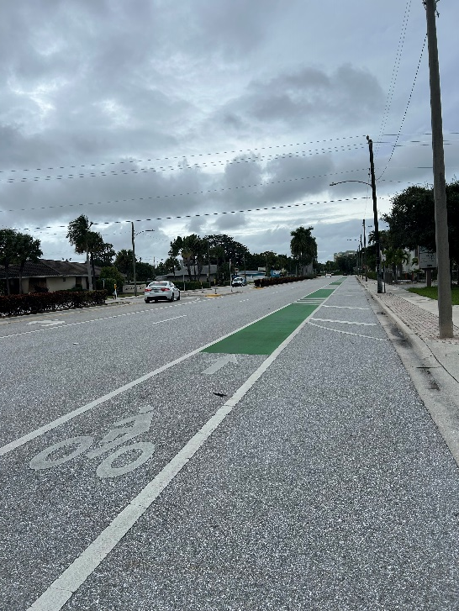
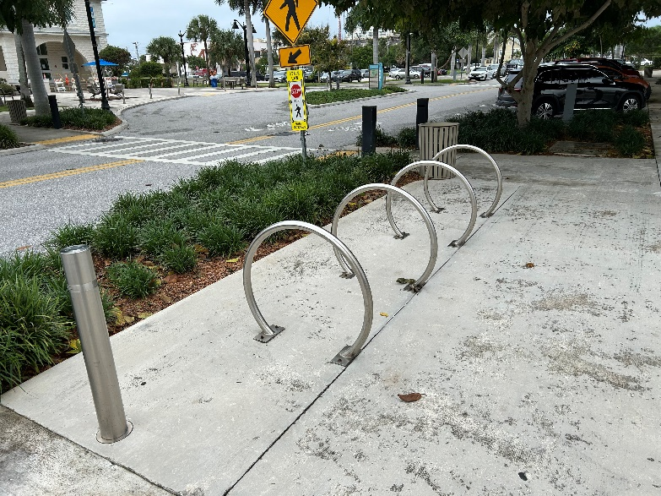
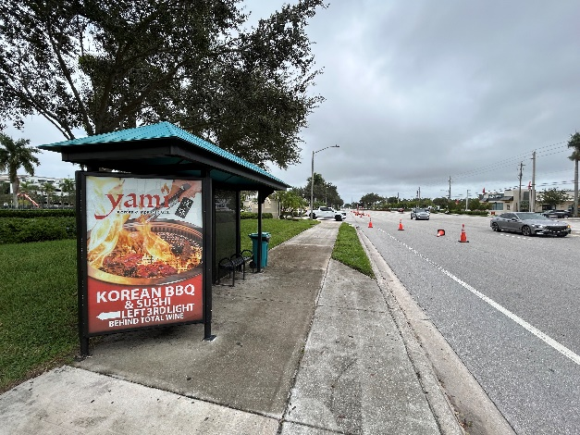
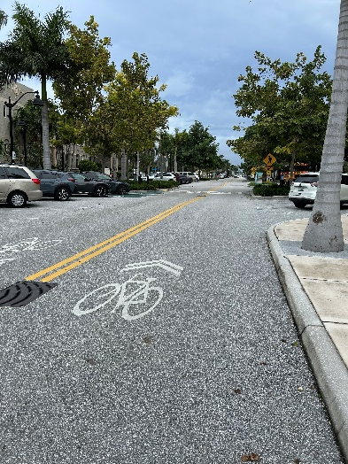
TRANSPORTATION AND MOBILITY ELEMENT
Complete Streets in Boynton Beach

Slide 41
TRANSPORTATION AND MOBILITY ELEMENT
Hurricane Evacuation Routes and Other Pertinent Information
Roadway | General Area Served for Evacuation | Vulnerabilities
Boynton Beach Blvd (SR 804) | Primary east–west connector from barrier island and downtown to I-95 | Major evacuation route; connects to I-95 and US-441
Woolbright Road | Primary east–west connector from coastal areas to I-95 | Congestion at interchange; critical evacuation link
Gateway Boulevard | Primary east–west connector to I-95 | Provides evacuation access from central/east Boynton Beach
Ocean Avenue (SR 804 spur) | Coastal connector from SR A1A to I-95 | Vulnerable to storm surge/flooding east of Intracoastal bridge
SR A1A (Ocean Blvd) | Coastal redistribution route | At risk from storm surge and coastal erosion; not reliable as inland evacuation route
I-95 | Regional north–south evacuation spine | Connects Boynton Beach evacuees to inland counties and north/south regions
US-1 (Federal Hwy) | Secondary north–south evacuation corridor | Provides local redistribution; not a primary long-distance evacuation facility
Local Collectors (Seacrest Blvd, Old Boynton Rd, MLK Jr Blvd) | Secondary evacuation feeders | Provide local access to shelters and evacuation routes

Slide 42
TRANSPORTATION AND MOBILITY ELEMENT
Updated Objective:
Expand and improve pedestrian and bicycle networks
Align with Complete Streets and Mobility Plan corridors
Enhance safety for all users
Improve accessibility and connectivity citywide
Support multimodal transportation options
Notes:
Objective 2.12: Promote a pedestrian- and bicycle-friendly environment by providing adequate facilities, such as wider sidewalks, buffers from travel lanes, shade trees, shorter crossing distances, lighting, refuges in large intersections, bike lanes, and bicycle parking, for pedestrians and bicyclists. Improve and expand a connected bicycle and pedestrian network, consistent with Complete Streets principles and the City’s Mobility Plan Multimodal Corridors, to increase safety, accessibility, and mobility options for all users.

Slide 43
TRANSPORTATION AND MOBILITY ELEMENT
Updated Policies:
Establish annual Mobility Report to track development, fees, and project delivery
Maintain a rolling 5 year list of prioritized multimodal transportation improvements
Align projects with City, FDOT, and MPO plans
Increase public transit use and reduce reliance on single occupancy vehicles
Track progress through ongoing mobility reporting
Notes:
Policy 2.1.10: The City shall publish an annual TCEA/Mobility Report documenting approvals versus TE-1 caps, Mobility Fee collections, and delivery of Mobility Plan projects. Beginning with the March 1, 2007 annual report shall include, the cumulative ratio of approved residential units to 1,000 square feet approved office and other non-residential uses.
Policy 2.2.1: The City shall maintain a rolling 5-year prioritized list of multimodal improvements aligned with the City CIP, FDOT Work Program, and the PBC MPO TIP. continue to establish and maintain an updated prioritized listing of short term (2013), and long term (2018) transportation improvements for use by the City.
Policy 2.11.6: Increase the City’s public transit journey-to-work mode share by 50% over the latest ACS 5-year baseline by 2030, with annual reporting in the TCEA/Mobility Report mode split for work trips to four percent as an effort to reduce motor vehicle use and traffic congestion. Based upon the 2000 Census, the public transportation mode split was 1.53 percent of all work trips by Boynton Beach residents.

Slide 44
TRANSPORTATION AND MOBILITY ELEMENT
Updated/Added Policies:
Maintain a GIS-based inventory of pedestrian and bicycle facilities
Regularly update data to support planning and decision-making
Identify gaps and safety issues in bike and pedestrian networks
Prioritize improvements based on need and risk
Apply Vision Zero principles to improve roadway safety
Emphasis on Quality of Service (QOS) standards
Notes:
Policy 2.12.1 Promote a pedestrian-friendly environment on streets within the TCEA and the CRA by providing adequate and comfortable facilities. The City shall maintain a GIS-based inventory of bicycle and pedestrian facilities (including sidewalks, curb ramps, crossings, bicycle lanes, shared-use paths, and trails) and update it at least annually.
Policy 2.12.2 By January 2007, the City shall complete an inventory of existing bicycle facilities within the City and place such an inventory in a geographic information system (GIS) to assist City staff identify gaps and priorities. Using the annual GIS inventory and crash/safety data, the City shall identify bicycle and pedestrian facility gaps and high-risk locations (including ADA deficiencies) and maintain a prioritized list of corrective projects.
Policy 2.12.8 The City shall apply Vision Zero principles to bicycle and pedestrian planning by prioritizing safety countermeasures on high-injury corridors and intersections, including improved crossings, lighting, speed management, and protected bicycle facilities where propriate.

Slide 45
UTILITIES ELEMENT

Slide 46
UTILITIES ELEMENT
Manages public facilities and services essential to growth and quality of life
Includes Sanitary Sewer, Potable Water, Stormwater, Solid Waste, and Groundwater Recharge
Ensures coordinated planning with regional agencies and sustainability goals
Supports resilience, water conservation, and infrastructure investment
Sub Elements:
Sanitary Sewer
Potable Water
Stormwater
Solid Waste
Groundwater Recharge
Service Area: 25.1 sq. miles; approx. 125,000 residents

Slide 47
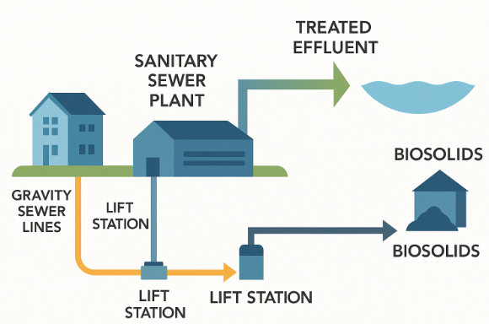
UTILITIES ELEMENT
Sanitary Sewer System
Partnered with South Central Regional Wastewater Treatment Plant
LOS: 100 gallons per capita per day
167 Lift Stations (7 Master Stations)
390 miles of Pipelines
7,982 Manholes
778 Cleanouts; 71 Air Release Valves

Slide 48
UTILITIES ELEMENT
Solid Waste Management
Managed by Palm Beach County SWA & Waste Management, Inc.
LOS: 7.7–8.0 lbs per capita per day
Recycling Rate: ~22%, Goal to Exceed 25%
Programs Emphasize Reduction, Reuse, and Education
Year | Population | MSW (tons/year) | Recycling (tons/year) | Total Collected (tons/year) | Recycling Rate (%)
2020 | 118,900 | 207,000 | 49,000 | 256,000 | 19 %
2025 | 125,000 | 217,000 | 54,000 | 271,000 | 20 %
2030 | 132,000 | 229,000 | 60,000 | 289,000 | 21 %
2035 | 138,000 | 238,000 | 66,000 | 304,000 | 22 %
2040 | 145,000 | 248,000 | 72,000 | 320,000 | 23 %
2045 | 152,000 | 259,000 | 78,000 | 337,000 | 23 %

Slide 49
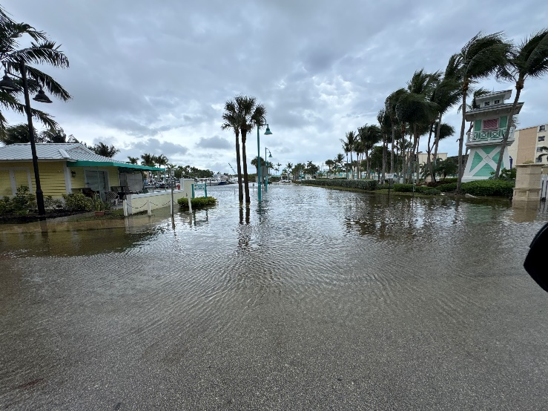
UTILITIES ELEMENT
Stormwater Management
Includes major outfalls, canals, culverts, pumps
LOS: 25-year, 3-day storm protection standard
Partners: SFWMD, LWDD, FDOT
Resilience upgrades: tide valves, pump maintenance

Slide 50
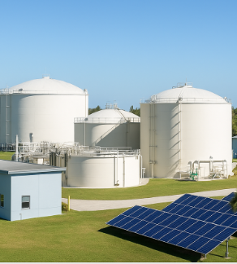
UTILITIES ELEMENT
Potable Water System
Two treatment plants: East (24 MGD), West (10.4 MGD)
LOS: 154 gallons per capita per day; Buildout: 32 MGD
Expanding Reclaimed Water and Conservation Measures
Reduces Potable Water Demand

Slide 51
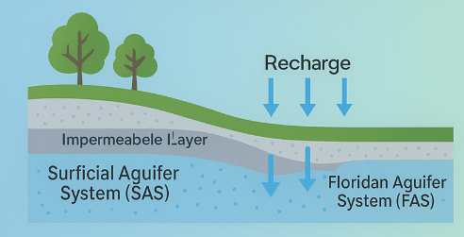
UTILITIES ELEMENT
Groundwater Recharge & Wellfield Protection
Relies on Surficial and Floridan Aquifers
CUP #50-00499-W, 20.86 MGD Allocation
Wellfield Protection and Monitoring Programs
Reuse Projects, Reduce Withdrawal

Slide 52
UTILITIES ELEMENT
Updated/Added Objectives:
Objective 3C.7 – Water Supply
Implement Water Supply Facilities Work Plan through planning horizon
Diversify water sources to reduce groundwater dependence
Improve infrastructure efficiency and system reliability
Objective 3E.7 – Growth Management
Discourage urban sprawl and support compact development
Limit extension of utilities beyond planned service areas
Ensure consistency with Future Land Use and service standards
Notes:
Objective 3C.7 The City of Boynton Beach will implement the Water Supply Facilities Work Plan (WSFWP) in order to meet the City’s water demand through 2030. The Work Plan will promote projects aimed at diversifying the City’s sources of water to reduce dependency on the surficial acquifer and improvement of existing infrastructure to enhance the system’s efficiency. and maintain the Water Supply Facilities Work Plan (WSFWP) in order to meet the City’s water demand through the adopted planning horizon. The Work Plan will promote projects aimed at diversifying the City’s sources of water to reduce dependency on groundwater supplies and improving existing infrastructure to enhance the system’s efficiency.
Objective 3E.7 Prevention of Urban Sprawl. The City shall continue to discourage urban sprawl and continue as a compact urban area by not providing services beyond 1/2 mile of the existing urbanized areas. maintain compact development patterns by limiting the extension of utility services to the established utility service area(s) and by requiring that any extensions be consistent with the Future Land Use Element, interlocal agreements, and adopted level-of-service standards.

Slide 53
UTILITIES ELEMENT
Updated/Added Policies:
Evaluate need for sanitary sewer service for larger developments
Plan for capacity, infrastructure, and future demand
Identify wastewater facility capacity and connection needs
Establish timelines for sewer system improvements
Monitor and reduce infiltration and inflow in sewer system
Improve system efficiency and reduce excess flows
Notes:
Policy 3A.1.5 For any proposed development of more than 50 residential lots, whether built or unbuilt, with more than one onsite sewage treatment and disposal system per 1 acre, the City shall evaluate the feasibility of providing sanitary sewer service within a 10-year planning horizon and shall identify: (1) the name and location of the wastewater facility that could receive sanitary sewer flows after connection; (2) the capacity of the facility and any associated transmission facilities; (3) the projected wastewater flow at that facility for the next 20 years, including expected future new construction and connections of onsite sewage treatment and disposal systems to sanitary sewer; and (4) a timeline for the construction of the sanitary sewer system, consistent with Section 163.3177(6)(c)3., Florida Statutes.
Policy 3A.3.1 The City shall strive to increase the average annual daily flow to the Central Regional Wastewater Treatment Plant up to 90% of the average flow from the water treatment plants as further conservation measures such as increased use of reuse water take effects. continue to monitor infiltration and inflow (I/I) to determine rates and locations within the collection system. Where technically and economically feasible, the City shall implement system improvements to reduce I/I and minimize non- wastewater flows to the regional wastewater treatment facility.

Slide 54
UTILITIES ELEMENT
Updated/Added Policies:
Enforce stormwater retention and detention requirements for development
Ensure compliance with state and regional water quality standards
Promote water conservation and efficiency measures
Reduce potable water demand through reuse and system improvements
Maintain per capita water use within adopted service standards
Notes:
Policy 3B.2.7 The City shall continue to enforce the land development regulations requiring that retention and/or detention in for new developments will conform to the water quality requirements of Chapter 62‑25, Florida Administrative Code. and redevelopment conform to applicable Environmental Resource Permit (ERP) water-quality and water-quantity criteria, as set forth in Chapter 62- 330, Florida Administrative Code, and the applicable rules, manuals, and requirements of the South Florida Water Management District (SFWMD) and the Lake Worth Drainage District (LWDD).
Policy 3C.1.1 The City shall maintain its per capita average day water usage at the current 131 gpcd or less through continuous implementation of water conservation programs, distribution loss reduction and reclaimed water projects. implement water-conservation, distribution loss reduction, and reclaimed-water initiatives to minimize increases in potable-water demand and to maintain per-capita water use consistent with the adopted level-of-service standard and applicable regional water supply planning assumptions.

Slide 55
CAPITAL IMPROVEMENT

Slide 56
CAPITAL IMPROVEMENT ELEMENT
Assess the City’s Public Facility Deficiencies
City of Boynton Beach’s five-year Capital Improvement Schedule (CIS)
Funding Sources per Fiscal Year
Level of Service Standards for City Public Facilities
Summary of Major Capital Projects and Facilities

Slide 57
CAPITAL IMPROVEMENT ELEMENT
Highlighted Objectives:
Invest in infrastructure to address deficiencies and support future growth
Replace aging and obsolete public facilities
Ensure development is aligned with available infrastructure and level of service standards
Maintain a financially feasible capital improvements program
Require fair-share contributions from developers for infrastructure improvements

Slide 58
CAPITAL IMPROVEMENT ELEMENT
Highlighted Policies:
Include essential public facilities in Capital Improvements planning
Support public health, safety, and quality of life
Evaluate infrastructure capacity and funding needs in redevelopment areas
Require development to contribute fairly to infrastructure costs
Utilize a range of funding tools (fees, assessments, dedications)

Slide 59
CONSERVATION

Slide 60
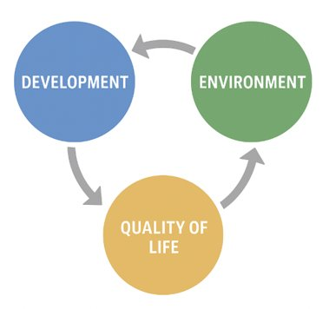
CONSERVATION ELEMENT
Core Component of the City’s Comprehensive Plan
Focuses on Natural Resource Management:
  Air and Water Quality
  Wetlands, Uplands, and Native Habitats
  Water Conservation and Reuse
  Flood and Soil Management

Slide 61
CONSERVATION ELEMENT
Current Conservation Goals
1. Maintain air and water quality
2. Protect groundwater and wellfields
3. Reduce stormwater pollutants
4. Eliminate ocean wastewater discharges
5. Preserve native ecosystems and wildlife
6. Encourage water and energy conservation
7. Minimize flooding and erosion

Slide 62
CONSERVATION ELEMENT
Updated Goal:
Protect and restore natural resources including air, water, and ecosystems
Enhance environmental quality and community resilience
Promote long-term sustainability and livability
Plan for environmental needs through 2035 and 2050
Notes:
Goal 4: The development and maintenance of a high quality natural environment based on the preservation, improvement and wise exploitation of local existing natural resources. Protect, conserve, enhance, and restore the City’s natural resources, including air, water, soils, wildlife, and ecosystems, in order to maintain a high-quality natural environment, support community resilience, and ensure the long-term sustainability and livability of Boynton Beach for the next 10 (2035) and 20 (2045) year planning periods.

Slide 63
CONSERVATION ELEMENT
Added/Updated Objectives:
Protect and maintain groundwater quality and supply
Safeguard key aquifers and wellfield protection areas
Plan for and respond to climate change impacts
Address sea level rise, flooding, and extreme weather
Expand tree canopy and vegetative cover
Reduce urban heat and improve air quality
Notes:
Objective 4.2 Through 2018 the City shall maintain ground water quality equal to or better than existing levels for recognized pollutants and conserve, appropriately use and protect the quality and quantity of groundwater. Protect the Surficial Aquifer, Floridan Aquifer, and all wellfield protection areas to maintain groundwater quality and quantity equal to or better than current conditions. Protect the Surficial Aquifer, Floridan Aquifer, and all wellfield protection areas to maintain groundwater quality and quantity equal to or better than current conditions.
Objective 4.10 The City shall evaluate, prepare for, and respond to climate related impacts, including sea-level rise, tidal flooding, extreme rainfall, groundwater rise, and extreme heat, to protect public safety, natural resources, and community resilience.
Objective 4.11 The City shall promote expansion and preservation of vegetative cover and shade to reduce urban heat island effects, improve air quality, and enhance community livability.

Slide 64
CONSERVATION ELEMENT
Added/Updated Policies:
Promote multimodal transportation and EV infrastructure
Reduce vehicle emissions and idling
Maintain and update wellfield protection standards
Ensure consistency with state and regional regulations
Expand use of reclaimed and alternative water sources
Reduce reliance on groundwater
Require stormwater retention and detention for development
Ensure compliance with City and SFWMD standards
Notes:
Policy 4.1.3 Encourage multimodal transportation, electric vehicle charging infrastructure, and idle-reduction policies to reduce mobile- source emissions.
Policy 4.2.6 The City shall maintain and update the Wellfield Protection Ordinance consistent with FDEP and SFWMD standards.
Policy 4.2.7 The City shall promote use of reclaimed water and other alternative water supplies to reduce groundwater withdrawals.
Policy 4.3.1 The City shall continue to enforce and, where appropriate, improve subdivision regulations to require all new development or substantial redevelopment to provide on-site retention or detention of at least the first inch of rainfall. require all new development and substantial redevelopment to retain/detain runoff consistent with the City’s stormwater design standards and SFWMD criteria.

Slide 65
CONSERVATION ELEMENT
Added/Updated Policies:
Assess stormwater system vulnerability to sea level rise and flooding
Explore aquifer recharge and advanced water treatment solutions
Encourage innovative water management technologies
Support land conservation and ecosystem restoration efforts
Protect wetlands and minimize environmental impacts
Ensure compliance with state and federal regulations
Protect manatee habitat through coordinated management strategies
Notes:
Policy 4.3.8 The City shall continue to evaluate stormwater infrastructure for vulnerability to sea-level rise and tidal flooding, and prioritize upgrades in the Capital Improvements Element.
Policy 4.4.3 Evaluate opportunities for aquifer recharge, advanced wastewater treatment, or other innovative technologies consistent with SFWMD guidance.
Policy 4.5.6 The City shall encourage acquisition, conservation easements, restoration partnerships, and leveraging of Resilient Florida funding programs for ecosystem protection.
Policy 4.6.6 The City shall require protection of wetlands consistent with FDEP and USACE jurisdictional determinations, including avoidance and minimization of impacts.
Policy 4.7.4 The City shall protect manatee habitat through implementation of manatee protection zones and coordination with FWC.

Slide 66
CONSERVATION ELEMENT
Added/Updated Policies:
Promote water efficiency through high-efficiency fixtures and landscaping standards
Integrate sea level rise and flooding projections into infrastructure planning
Strengthen long-term resilience strategies
Coordinate with regional agencies on climate data and resilience planning
Utilize latest climate science and vulnerability assessments
Reduce heat and improve comfort in public and private spaces
Notes:
Policy 4.8.8 The City shall implement high-efficiency fixture standards, irrigation audits, and drought-tolerant landscape requirements for new development.
Policy 4.9.5 The City shall integrate sea-level rise projections, compound flooding, and tidal backflow considerations into stormwater and infrastructure planning pursuant to F.S. §163.3177(6)(d) and the Resilient Florida Program.
Policy 4.10.1 The City shall coordinate with the Southeast Florida Regional Climate Change Compact, Palm Beach County Office of Resilience, SFWMD, and FDEP Resilient Florida Program to obtain the latest vulnerability assessments, sea-level rise projections, and climate science relevant to Boynton Beach.
Policy 4.11.1 The City shall encourage planting of native shade trees in parking lots, along City rights-of-way, within new development, and throughout parks and open spaces to increase canopy coverage and reduce surface temperatures.

Slide 67
RECREATION/OPEN SPACE

Slide 68
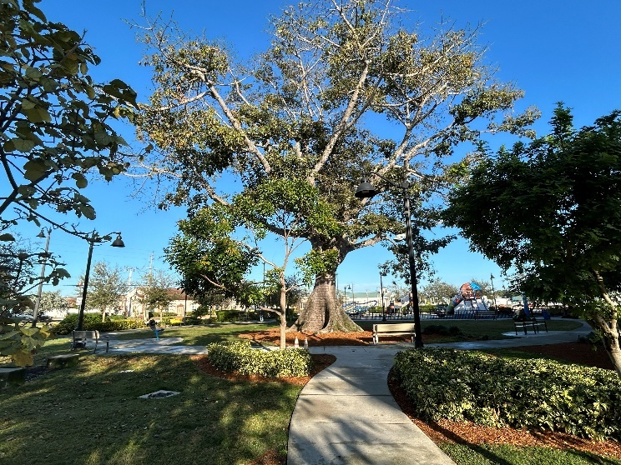
RECREATION/OPEN SPACE ELEMENT
Classification and Inventory of Parks and Recreational Facilities
Level of Service Analysis for Parks and Open Spaces throughout the City.
Commitment to Greenways, Blueways, and Preserving Natural Areas
Future Parks

Slide 69
RECREATION/OPEN SPACE ELEMENT
Neighborhood Parks
The neighborhood park is a "walk to" park generally located along streets where people can walk or bicycle without encountering heavy traffic.
Community Parks
A community park is a "ride to" park located near major streets or arterials. It is designed to serve community residents within a radius of up to three miles. Multi-modal access to community parks is strongly encouraged. Multi-modal access can be enhanced by bike paths and pedestrian walkways.

Slide 70
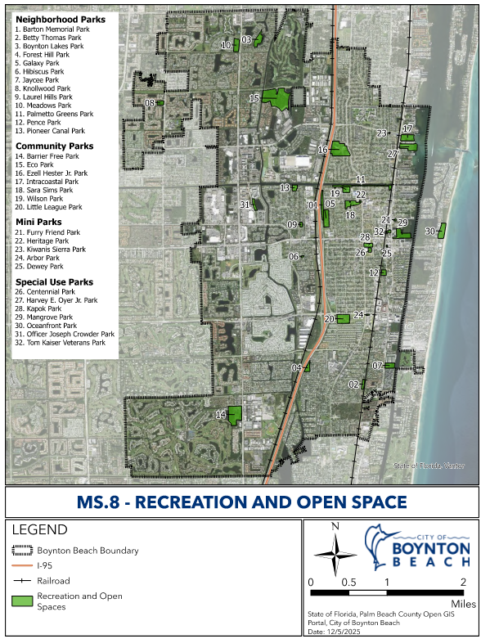
RECREATION/OPEN SPACE ELEMENT

Slide 71
RECREATION/OPEN SPACE ELEMENT
PARK NAME FACILITY TYPE ACREAGE | FACILITY TYPE | ACRES
CURRENT PARKS
Eco Park | Community | 59.0
Ezell Hester, Jr. Community Park | Community | 23.81
Wilson Park | Community | 3.8
Sara Sims Park | Community | 7.82
Intracoastal Park | Community | 8.97
Barrier Free Park | Community | 20.25
Betty Thomas Park | Neighborhood | 2.33
Boynton Lakes Park | Neighborhood | 7.94
Forest Hills Park | Neighborhood | 3.59
Galaxy Park | Neighborhood | 9.78
Hibiscus Park | Neighborhood | 0.48
Knollwood Park | Neighborhood | 3.01
Laurel Hills Park | Neighborhood | 1.29
Meadows Park | Neighborhood | 7.16
Pence Park | Neighborhood | 2.89
Pioneer Canal Park | Neighborhood | 0.76
Barton Memorial Park | Neighborhood | 6.9
Jaycee Park | Neighborhood | 5.31
Palmetto Green Park | Neighborhood | 0.29
Subtotal |  | 175.38

Slide 72
RECREATION/OPEN SPACE ELEMENT
Level of Service Analysis (2020)
The level of service (LOS) established in the Comprehensive Plan does not divide the requirements by park type. The two and half acres per 1,000 population adopted LOS for the City of Boynton Beach for parks.
Existing Acreage* | LOS Standard | 2020 Population | Demand | Surplus
307.36 | 2.5/1,000 | 89,020 | 222.55 | 84.81
*The Existing Acreage includes Community Parks, Neighborhood Parks, Special Use, Conservations Lands, Urban Open/ Civic Space, Water/Beach Access, Future Parks, and some Indoor Facilities.
Notes:
According to the 2022 Parks and Recreation System Master Plan, several additional parks are currently under construction. With the inclusion of these future parks, the City will have a surplus of 84.86 acres, exceeding the required 222.5 acres based on its population

Slide 73
RECREATION/OPEN SPACE ELEMENT
Level of Service Analysis (2045)
The City’s current LOS requirements are based on the City requirements of two and a half (2.5) acres per 1,000 populations. Existing supply of City-owned and managed parks continue to show a sufficient surplus of park area for the current planning period and future planning periods
Existing Acreage* | LOS Standard | 2045 Population | Demand | Surplus
307.36 | 2.5/1,000 | 108,039 | 270.1 | 37.26
*The Existing Acreage includes Community Parks, Neighborhood Parks, Special Use, Conservations Lands, Urban Open/ Civic Space, Water/Beach Access, Future Parks, and some Indoor Facilities.

Slide 74
RECREATION/OPEN SPACE ELEMENT
Updated Goal:
Updated Goal 5
Create an interconnected system of parks, greenways, and open spaces
Ensure accessibility, safety, and resilience
Enhance quality of life for residents and visitors
Support future population growth through 2050
Protect natural resources through park and open space planning
Notes:
Goal 5 To create and maintain an interconnected system of aesthetically pleasing, functional, and well-maintained parks, pedestrian/ bikeways, greenways, blueways and natural areas that will adequately serve the needs of the current and future residents of the City of Boynton Beach, including seasonal visitors, and special groups such as the elderly and handicapped. The City shall also continue to provide a variety of high quality parks and recreation related programs for all residents. Create and maintain interconnected, accessible, safe, and resilient parks, recreation, greenway, and open space system that serves all residents and visitors, enhances quality of life, protects natural resources, and supports population growth for the next 10 (2035) and 20 (2045) year planning periods.

Slide 75
RECREATION/OPEN SPACE ELEMENT
Updated Objectives:
Objective 5.2 – Access to Parks
Improve multimodal access to parks, recreation, and waterfront areas
Enhance connectivity for pedestrians, bicyclists, and vehicles
Ensure equitable access across the community
Objective 5.3 – Park Facilities & Standards
Plan for park and recreation needs based on population growth
Maintain level of service standards for facilities
Ensure parks and recreation improvements keep pace with development
Notes:
Objective 5.2 The City shall ensure adequate and safe public access to all existing and future City parks, recreational facilities, and local waterways. This effort shall include vehicular, pedestrian, trail, bicycle, and handicapped access and shall continue to improve and increase access to parks and recreational facilities, where available space exists, by providing adequate automobile parking, bike rack facilities, and handicap access to all existing and planned, neighborhood and community parks operated by the City by the year 2013. equitable, multimodal access to all parks, recreation facilities, and waterfront areas.
Objective 5.3 The City shall establish and enforce standards and programs to ensure the acquisition and development of park sites and recreational facilities sufficient to meet current and future demands. The City shall also ensure additional public access to recreation sites by providing parks and recreation facilities using, in part, current population data and projections, and implementing the improvements outlined in Exhibit 2, Proposed Improvements to the Parks and Recreation System, included in the Strategic Plan. maintain adopted LOS standards and ensure adequate park and recreation facilities are available concurrent with development.

Slide 76
RECREATION/OPEN SPACE ELEMENT
Updated Policies:
Provide a diverse range of recreation programs for all age groups and abilities
Monitor and adapt programs to meet community needs
Maintain a GIS-based inventory of parks, facilities, and amenities
Implement Parks and Recreation Master Plan projects and update regularly
Identify and acquire land to expand parks and open space
Notes:
Policy 5.1.2 The City shall continue to provide a variety of parks and recreation programs for its residents, including the City’s baseball, softball, and soccer programs, and other programs for tennis, racquetball, and other activities as needed. The City shall continue to offer recreational programs that complement and enhance the use of the City's recreational facility assets. The City shall annually monitor recreation programs to ensure that an adequate diversity of programs addresses the recreation interests of different age groups, particularly children, teenagers, and the elderly. Additionally, the City shall ensure that residents with special needs are adequately accommodated.
Policy 5.1.4 The City shall maintain a GIS-based inventory of all parks, facilities, amenities, and classifications consistent with the Parks & Recreation Master Plan.
Policy 5.3.5 The City shall pursue the development of facilities consistent with Exhibit 1, Future Parks and Recreation System Map, and Exhibit 2, Proposed Parks and Recreation System Improvements, included in the Strategic Plan which shall be updated annually. implement projects identified in the Parks & Recreation System Master Plan and update annually.
Policy 5.7.6 The City will identify properties available for acquisition and/or vacant or underutilized properties, and consider acquiring these properties in order to expand its inventory of usable recreation and open space.

Slide 77
COASTAL MANAGEMENT

Slide 78
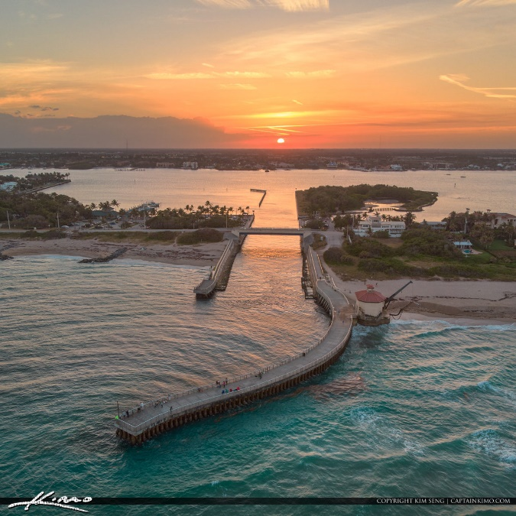
COASTAL MANAGEMENT ELEMENT
Coastal Infrastructure and Natural Resources Analysis
Analysis of Disaster Planning Issues and Hazard Reduction
Sea Level Rise Impact Projections for Publicly-Financed Construction
Resilient Florida (Sec. 380.093, F.S., 2021), National Flood Insurance Program (NFIP), Community Rating System (CRS),

Slide 79
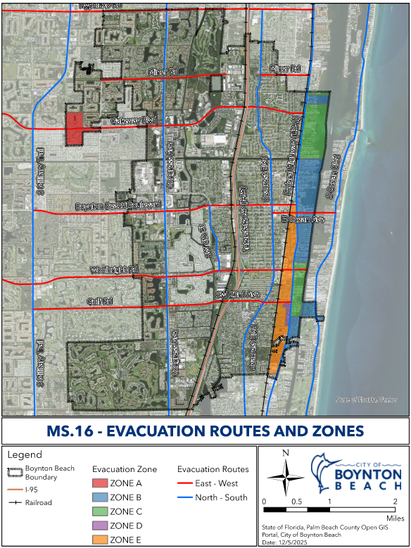
COASTAL MANAGEMENT ELEMENT

Slide 80
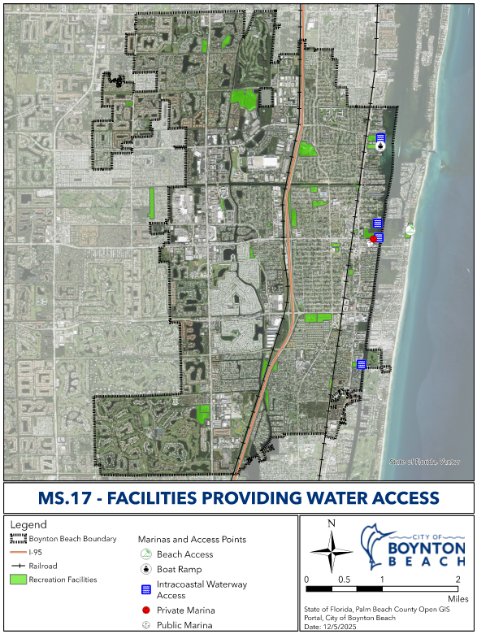
COASTAL MANAGEMENT ELEMENT

Slide 81
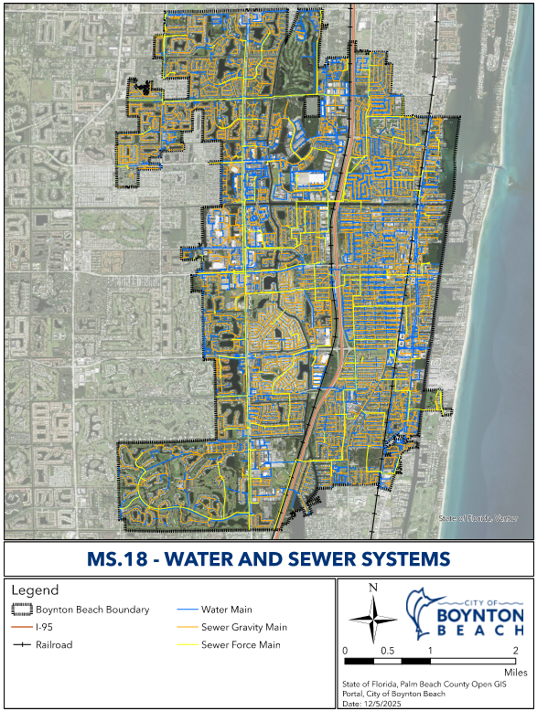
COASTAL MANAGEMENT ELEMENT

Slide 82
COASTAL MANAGEMENT ELEMENT
Updated Goal 7:
Protect public safety and reduce risk from coastal hazards
Limit public investment in high-risk areas
Preserve coastal, marine, and estuarine resources
Support resilient redevelopment patterns
Enhance public access and recreational opportunities
Strengthen long-term coastal resilience through 2050
Notes:
Goal 7 To develop and maintain the Coastal Management area in a manner which protects human life, limits public expenditures in areas subject to destruction by natural disasters while preserving beach, shoreline, marine, wildlife, and recreational resources. Protect human life, safeguard coastal and estuarine resources, support resilient redevelopment patterns, and limit public expenditures in areas subject to natural hazards while enhancing public access, recreational value, natural ecosystems, and long-term coastal resilience for the next 10 (2035) and 20 (2045) year planning periods.

Slide 83
COASTAL MANAGEMENT ELEMENT
Updated Objectives:
Objective 7.3 – Beaches & Dunes
Protect, manage, and enhance beach and dune systems
Minimize impacts from man-made structures
Coordinate with federal, state, and regional partners
Objective 7.6 – Coastal Resilience
Assess and reduce risks from coastal flooding and hazards
Address sea level rise, storm surge, and high-tide events
Promote resilient redevelopment and engineering solutions
Notes:
Objective 7.3 Subsequent to Plan adoption, or when mandated by state statute, the City, in cooperation with Federal, State, County, and adjacent governments will protect and restore the existing coastal dune system and beaches along the City's beachfront and establish standards to minimize the beach and dune impacts of man-made structures. Protect, manage, and enhance beaches and dune systems while minimizing impacts from man-made structures.
Objective 7.6 The City shall continue to assess the current and future risks to human life and property from floods and other natural hazards in the coastal areas and implement development and redevelopment strategies that reduce such risks. by reducing risks from coastal flooding, storm surge, high-tide events, sea-level rise and incorporating redevelopment principles and engineering solutions that increase resilience.

Slide 84
COASTAL MANAGEMENT ELEMENT
Added/Updated Policies:
Require coastal development to reduce flood risk and sea level rise impacts
Pursue funding for infrastructure and engineering solutions to reduce coastal flooding
Ensure water resource regulations align with regional permitting standards
Integrate Climate Action Plan into the Comprehensive Plan
Notes:
Policy 7.1.3 The City shall require all coastal development to incorporate site design that reduces vulnerability to future flood conditions, including projected SLR and king tide flooding.
Policy 7.1.6 The City shall seek funding for studies and infrastructure improvements to implement engineering solutions that reduce flood risk in the coastal zone.
Policy 7.5.7 The City will ensure that any new regulation to protect water resources is consistent with SFWMD’s environmental resource and consumptive use permitting rules.
Policy 7.9.3 By the end of 2017, tThe City shall integrate its Climate Action Plan and subsequent plans into elements of the Comprehensive Plan as appropriate.

Slide 85
INTERGOV. COORDINATION

Slide 86
INTERGOV. COORDINATION ELEMENT
This Element is Organized into Two (2) Principal Sections.
The First Section provides an inventory of existing intergovernmental coordination arrangements between the City of Boynton Beach and other governmental entities.
The Second Section provides an analysis of these arrangements and their current effectiveness.
Overall: Coordination between Local, Regional, State, and Federal Agencies

Slide 87
INTERGOV. COORDINATION ELEMENT
State Regulations:
Florida Statutes Chapter 163: describes the provisions required within the Intergovernmental Coordination Element of the local comprehensive plan
Florida Statutes Chapter 187: Comprehensive Plan, contains many policies which impact intergovernmental coordination, including land use, public facilities, transportation, government efficiency, and plan implementation.
Other Agreements:
Interlocal Agreements: Allow governments to cooperate with one another in the performance of tasks, thereby reducing a duplication of services and possibly increasing cost efficiency.
Mutual-Aid Agreements: Mutual-aid agreements are in existence to assist the member entities in road maintenance, aid to libraries; water interconnects in times of need, dredging, public safety services, and social services.

Slide 88
INTERGOV. COORDINATION ELEMENT
Added/Updated Policies:
Coordinate with regional and local agencies on comprehensive planning
Support intergovernmental coordination and conflict resolution
Participate in regional transportation planning (MPO)
Use regional plans to guide updates to City transportation planning
Notes:
Policy 8.2.2 The City shall participate in the IPARC process and shall coordinate with the Treasure Coast Regional Planning Council and all other local governments on a voluntary dispute resolution process for the purpose of facilitating intergovernmental coordination, and shall include results and any written determination from the IPARC process as data and analysis with proposed and adopted Comprehensive Plan amendments transmitted to the Department of Economic Opportunity State land planning agency (Florida Department of Commerce).
Policy 8.6.1 The City shall continue to participate in the Palm Beach Transportation Planning Agency’s Palm Beach Metropolitan Planning Organization (MPO) long range planning process and utilize the resulting plans to update the City’s Transportation Element as appropriate.

Slide 89
ECONOMIC DEVELOPMENT

Slide 90
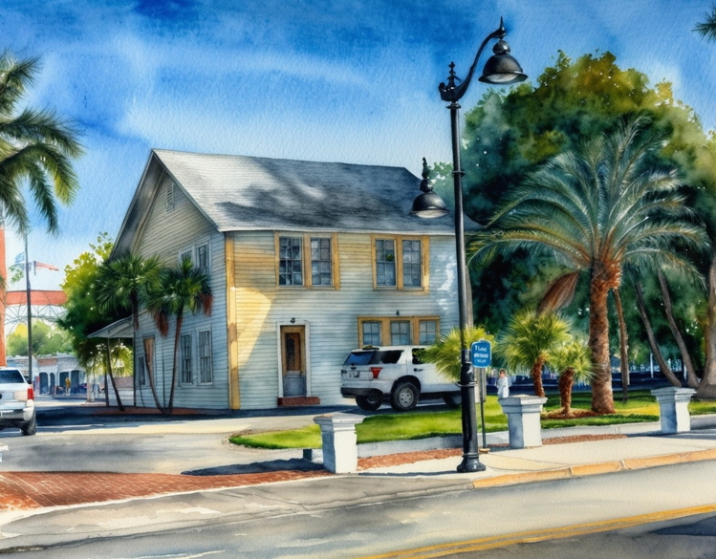
ECONOMIC DEVELOPMENT ELEMENT
Create Conditions for a Prosperous, Inclusive, and Sustainable Economy
Integrate with City’s Economic Development Strategic Plan (2025-2035)
Focus on Innovation, Inclusivity, and Quality of Life
Framework: LIVE, LEARN, WORK, PLAY

Slide 91
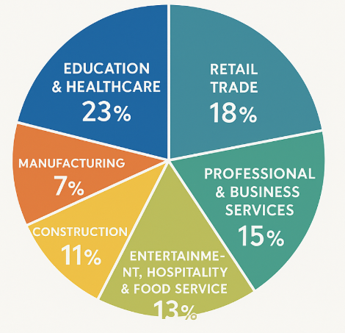
ECONOMIC DEVELOPMENT ELEMENT
Employment & Business Base – WORK
Civilian employment: 42,000 jobs (+15% since 2010)
Top occupations: Management, business, science (36.6%), Services (24.8%)
BBCRA: $3.3M+ in business grants supporting 100+ local businesses
Target industries: Marine tech, healthcare, creative industries, green construction

Slide 92
ECONOMIC DEVELOPMENT ELEMENT
Key Challenges & Opportunities
Challenges:
Housing affordability
Workforce alignment
Infrastructure needs
Climate resilience
Opportunities:
Infill housing & mixed-income redevelopment
Expand workforce training
Invest in digital & mobility systems
Additional office space and employment opportunities

Slide 93
ECONOMIC DEVELOPMENT ELEMENT
Added Goal 10:
Promote a diversified and resilient local economy
Support job creation and private investment
Strengthen the City’s commercial tax base
Maintain community character and quality of life
Plan for long-term economic sustainability through 2045
Notes:
Goal 10: To promote a diversified, resilient, and sustainable local economy that supports job creation, encourages private investment, strengthens the City’s commercial tax base, while maintaining the character and quality of life of Boynton Beach for the next 10 (2035) and 20 (2045) year planning periods

Slide 94
ECONOMIC DEVELOPMENT ELEMENT
Added Objectives:
Support a business-friendly environment and small business growth
Strengthen economic vitality in key areas (downtown, waterfront, corridors)
Enhance workforce development through education and job training
Align workforce programs with target industries
Promote redevelopment and mixed-use activity centers
Ensure infrastructure and regulations support economic growth
Improve efficiency and predictability of development processes
Notes:
Objective 10.1 Foster a business-friendly environment; support entrepreneurship and small business development; enhance workforce readiness; and strengthen the economic vitality of its downtown, waterfront, and commercial corridors
Objective 10.2 Enhance workforce readiness by supporting education, skills training, and job-placement programs aligned with the City’s target industry sectors.
Objective 10.3 Promote redevelopment and reinvestment in downtown, the waterfront, Congress Avenue, and other priority corridors to create vibrant, walkable, mixed-use economic centers.
Objective 10.4 Ensure that infrastructure, public services, and regulatory frameworks support economic development and facilitate predictable, efficient, and transparent development processes.

Slide 95
ECONOMIC DEVELOPMENT ELEMENT
Added Policies:
Retain and expand existing businesses while attracting new investment
Support job growth and economic opportunities
Partner with local institutions to expand workforce training
Focus on high-demand and emerging industries
Advance redevelopment in key areas (downtown, waterfront, districts)
Improve permitting and development review processes
Track economic trends through annual reporting
Monitor growth, jobs, and tax base performance
Notes:
Policy 10.1.1 The City shall strengthen the City’s economic base by retaining existing businesses, assisting in their expansion, and attracting new investment to meet the employment needs of current and future residents.
Policy 10.2.1 The City shall collaborate with Palm Beach State College, Florida Atlantic University, CareerSource Palm Beach County, and other institutions to expand access to workforce training programs in healthcare, skilled trades, technology, green jobs, and emerging industries.
Policy 10.3.1 The City shall continue to implement redevelopment strategies in partnership with the BBCRA to revitalize downtown, the waterfront, and other targeted districts.
Policy 10.4.1 The City shall continuously improve permitting, zoning, and development review processes to enhance business and customer service.
Policy 10.5.1 The City shall maintain an annual economic indicators report, tracking employment, wages, business growth, vacancy rates, tax base diversification, and redevelopment activity.

Slide 96
Private Property Rights

Slide 97
PRIVATE PROPERTY RIGHTS ELEMENT
Highlighted Goals, Objectives, & Policies:
Protect constitutionally recognized private property rights
Consider property rights in local decision-making
Affirm rights to own, use, and improve property
Protect rights to privacy and exclude others
Allow property owners to transfer or dispose of property

Slide 98
CHALLENGES OF FLORIDA SENATE BILL 180 (2025)

Slide 99

STATE EMERGENCY MANAGEMENT LEGISLATION
Applies to Local Governments in Counties Under Federal Disaster Declarations
Effective retroactive to August 1, 2024
In Effect through October 1, 2027
What Does This Restrict?
Prohibits Adoption of more Restrictive or Burdensome:
  Comprehensive Plan Amendments
  Land Development Regulations (LDRs)
  Permitting or Development Review Processes
Applies Regardless of Whether Changes are Related to Storm Damage

Slide 100
CHALLENGES FOR EAR-BASED PLAN AMENDMENTS
Many Recommendations Involve:
  Resilience Standards
  Environmental Protections
  Floodplain and Coastal Policies
These Updates May Be Interpreted As “More Restrictive” Under SB 180
Current Planning Uncertainty…
Limited Guidance from the State on What is Allowed
Pending Litigation Challenging SB 180’s Scope and Constitutionality
Cities Statewide are Delaying, Modifying, or Segmenting Plan Updates
Key Risk = Policy Improvements could be legally challenged or invalidated…

Slide 101
WHAT THIS MEANS FOR OUR COMPREHENSIVE PLAN?
Policy Updates must be carefully Evaluated for SB 180 Compliance
Some Recommendations may need to be:
  Deferred
  Narrowly Tailored
  Structured as Non-regulatory Policy Direction
Ongoing Coordination with Legal Counsel and State Review Agencies is Critical

Slide 102
STEPS IN THE PROCESS
  Public Engagement Workshop #1
October 20,
2025
  Public Engagement Workshop #2
Date Day,
2025
November 13, 2025
  City Commission Workshop
March 26,
2026
  Transmittal to State and Agencies
Date Day,
2025
TBD
  Public Hearing (Adoption)
TBD
Date Day,
2025
After transmittal, the State will review and issue a report; then, Project Team will update document. City Commission Adoption (Second Reading).

Slide 103

NEXT STEPS
Integrate Today’s Feedback into Draft Elements
Finalize Draft Comprehensive Plan
Transmittal to State and Agencies (60 days to receive the Objections and Comments (ORC))

Slide 104
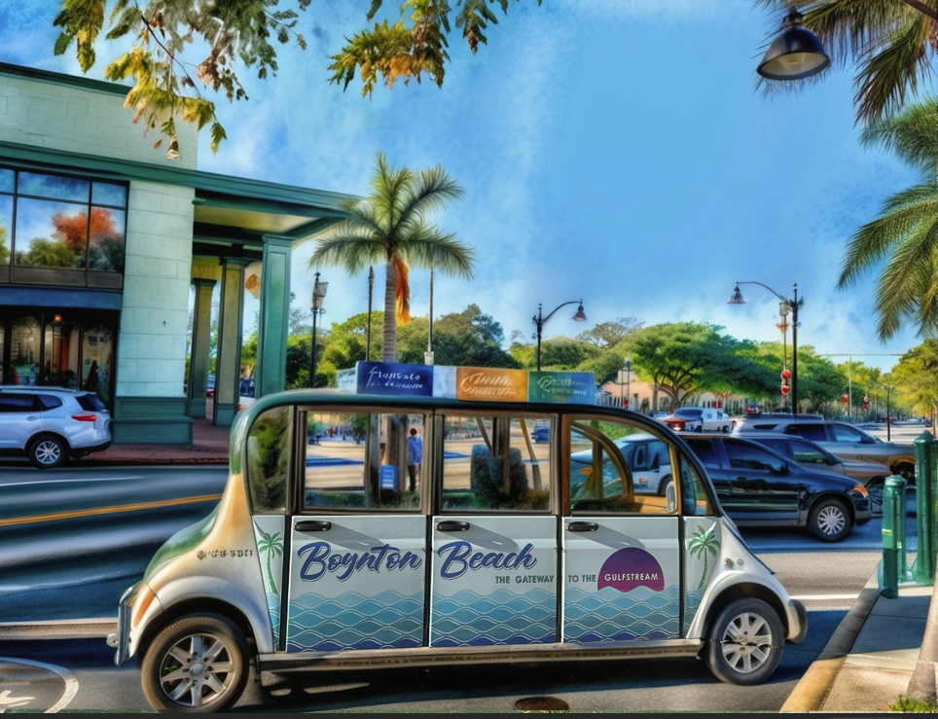
Thank you!
Let’s discuss priorities for Boynton Beach’s future!

